Slide 1

LOAN APPROVAL RISK
ANAND G

Slide 2
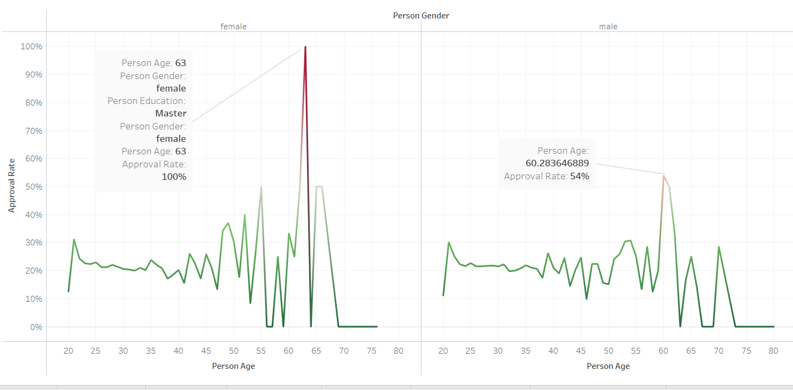
Approval rate by Demographics
Approval rates peak at 100% among 63-year-old females with a Master's degree, showcasing a demographic-specific trend.

Slide 3
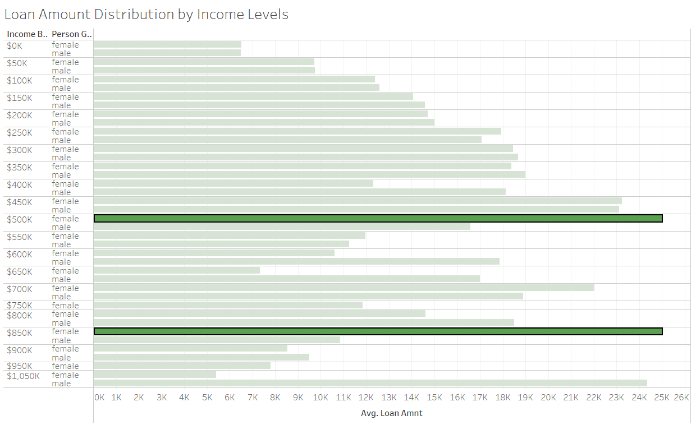
Loan Amount Distribution by Income Levels
The loan amount distribution shows consistent patterns for both genders across income levels, with females surpassing males in average loan amounts at specific income brackets.

Slide 4
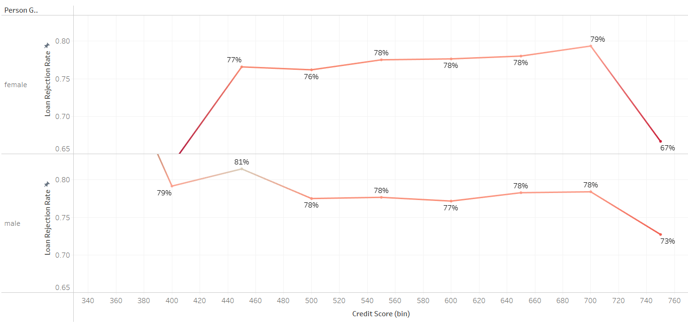
Default Rate by Credit History
Both male and female applicants exhibit comparable rejection rates initially. However, following rejection, the rate for females declines significantly, with 67% achieving credit scores exceeding 740.

Slide 5
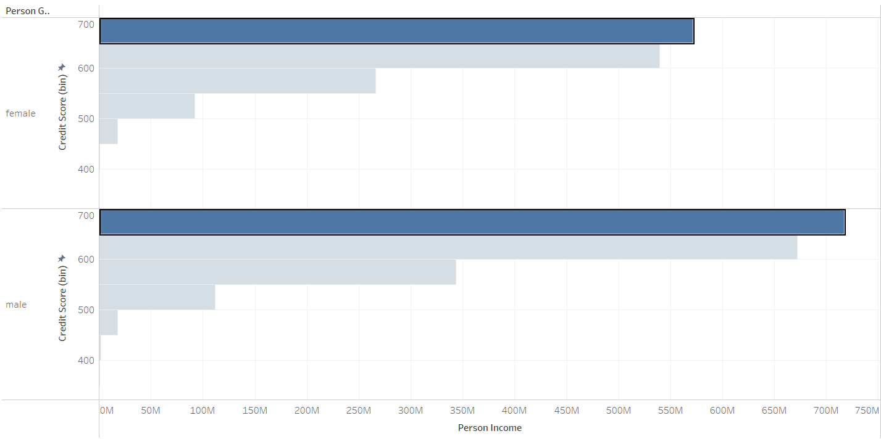
Credit score by Income
Males with higher income levels tend to have consistently higher credit scores.

Slide 6
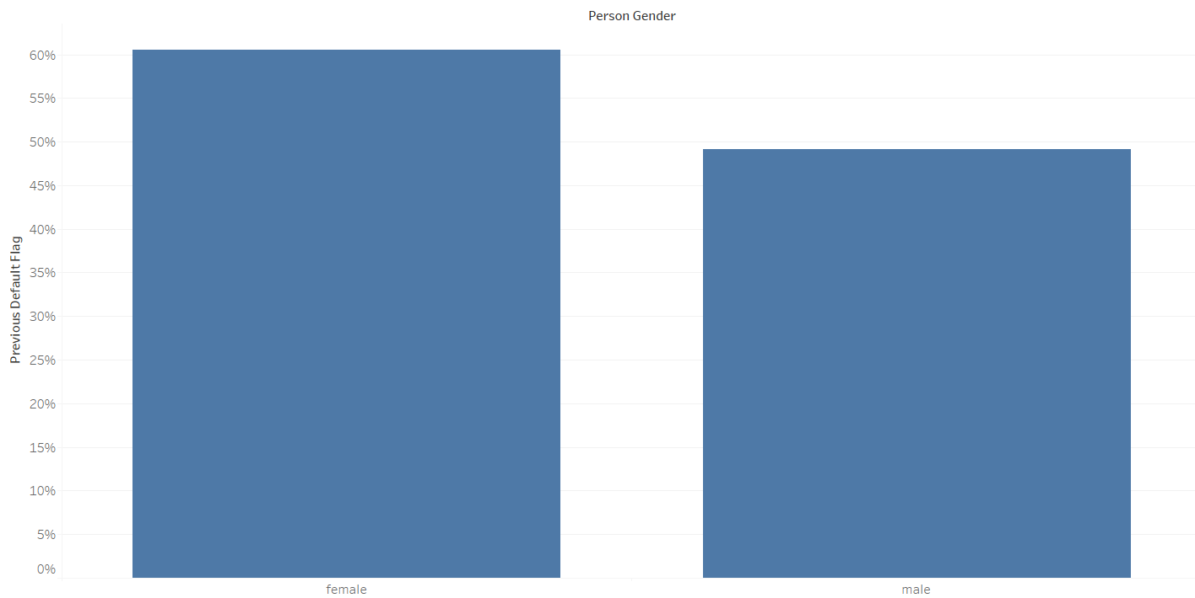

Previous loan default
The graph highlights that females have a higher previous loan default rate compared to males, exceeding 55%

Slide 7
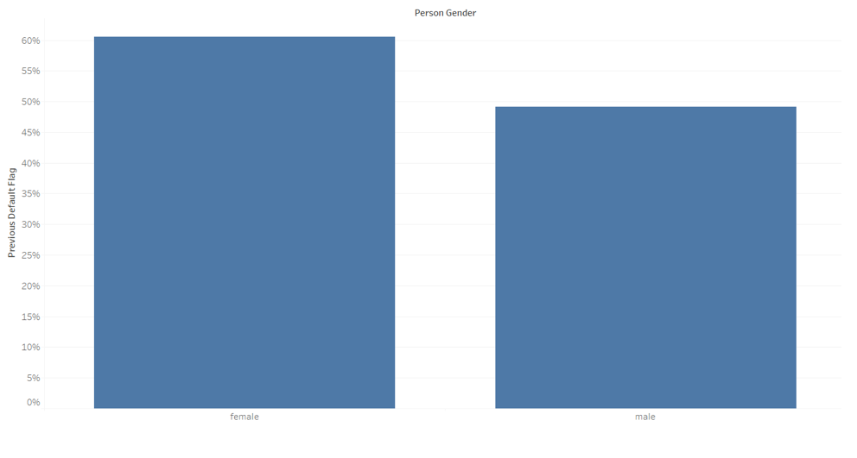
Conclusion:
Females have higher loan approval rates despite a greater incidence of previous defaults, indicating higher risk for the company. A data-driven approach can help reduce risks and improve decision-making.
Thank you

